Slide 1

UNIVERSITY ADMISSION in U.S.A shiva moosavi

Slide 2
Contents
Etymology
Data
High chance and Low chance of admission
Average GRE Score for two groups
T-test for GRE Score
T-Test for TOEFL Score
Conclusion

Slide 3
Etymology
GRE : An exam for graduate student including Math and English
TOEFL: A test to clarify English ability of student
GOP: The average grade score
RESEARCH: The research may have the student or not(0/1)
SOP: The Statement Of Purpose

Slide 4
The top 5 row of data
 | Serial No. | GRE Score | TOEFL Score | University Rating | SOP | CGPA | Research | Chance of Admit
 | 1 | 337 | 118 | 4 | 4.5 | 9.65 | 1 | 0.92
 | 2 | 324 | 107 | 4 | 4.0 | 8.87 | 1 | 0.76
 | 3 | 316 | 104 | 3 | 3.0 | 8.00 | 1 | 0.72
 | 4 | 322 | 110 | 3 | 3.5 | 8.67 | 1 | 0.80
 | 5 | 314 | 103 | 2 | 2.0 | 8.21 | 0 | 0.65

Slide 5
NulL Hypothesis
that the average GRE Score with high chance of admission is equal to average GRE Score with low chance of admission
that the average TOEFL Score with high chance of admission is equal to average TOEFL Score with low chance of admission

Slide 6
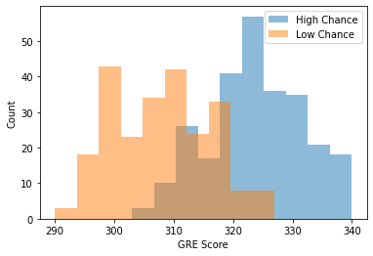
Histogram of gre score grouped by chance of admission
The grouped created based on the average chance of admission which is 0.72
The two groups histogram seems a normal distribution

Slide 7
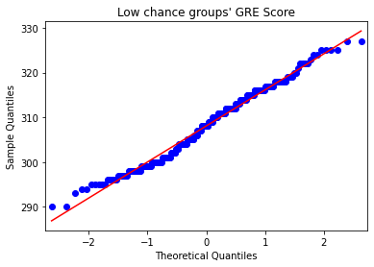
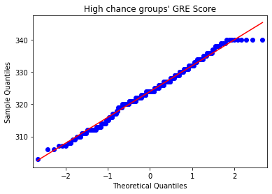
high chance and low chance of admission
The two plots confirm that two group distributions are Normal.
Notes:
Consider talking about:
Divergent plate boundaries
Convergent plate boundaries
Hotspots

Slide 8
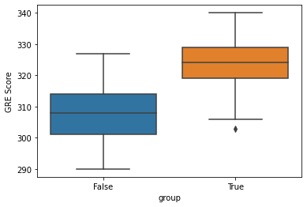
Box plot
Two box plot shows
The average GRE Score for High chance of admission group is more than the other group
There is some outlier for High chance of admission group
There are some high GRE Score that they are not in the group of High chance of admission, that may show other factors are important as well
Notes:
Consider talking about:
Fissure vents
Shield volcanoes
Lava domes
Cryptodomes
Volcanic cones (cinder cones)
Stratovolcanoes (composite volcanoes)
Supervolcanoes
Underwater volcanoes
Subglacial volcanoes
Mud volcanoes

Slide 9

T-test for gre score
We reject the NULL hypothesis because P_Value is very small (<0.05) SO it appears that the mean GRE score between the 2 groups is different
P= 1.4737323571414602e-75
Notes:
Consider talking about:
Popular classification of volcanoes
Technical classification of volcanoes

Slide 10
GRE score 95% Confidence interval
The difference in means at the 95% confidence interval (two-tail) is between -17.29 and -14.46.
The average GRE Score for those with higher chance of admission is approximately 14 to 17 Score more than the GRE Score who have less chance of admission.

Slide 11
T-test for toefl score
P= 3.0082116749464657e-64
We reject the NULL hypothesis because P-Value is very small (<0.05) SO it appears that the mean TOEFL score between the 2 groups is different
Notes:
Consider talking about:
Volcanic gases
Significant consequences
Acid rain
Hazards

Slide 12
TOEFL Score 95% confidence interval
The difference in means at the 95% confidence interval (two-tail) is between -8.85 and -7.26.
The average TOEFL Score for those with higher chance of admission is approximately 7.3 to 8.8 Score more than the TOEFL Score who have less chance of admission.

Slide 13
conclusion
According to the research, it is recommended all students who seeking to get admission for American universities allocate enough time for GRE and TOEFL exam because according to this study, these two criteria is very important to have high chance of admission.
GRE AND TOEFL exam are not the only factors for admission as shown by Box Plot.

Slide 14
Works cited
https://www.kaggle.com/mohansacharya/graduate-admissions
https://www.bankerslife.com/media/425215/recentcollegegrads.jpg color image on the first page

